Slide 1
Online Edu. Employment
Team VEL
07 Oct. 2015

Slide 2
1. Development Plan
Initialization
Design
Sprint01
Sprint02
Final Presentation

Slide 3
2. Project Achievement
100% of the initial product backlog is implemented over sprint01
100% of the additional product backlog is completed by sprint02

Slide 4
3. User Stories (Sprint 2)
Homepage polish
Test automation page
Contact us integration
Dynamic Team profile
New success stories List
Research on Google searching strategies

Slide 5
4. Homepage Polish
Change layout to present information more efficiently
Add visitor counter for statistics
Add Contact us link
Cut the height of main image on phone view

Slide 6
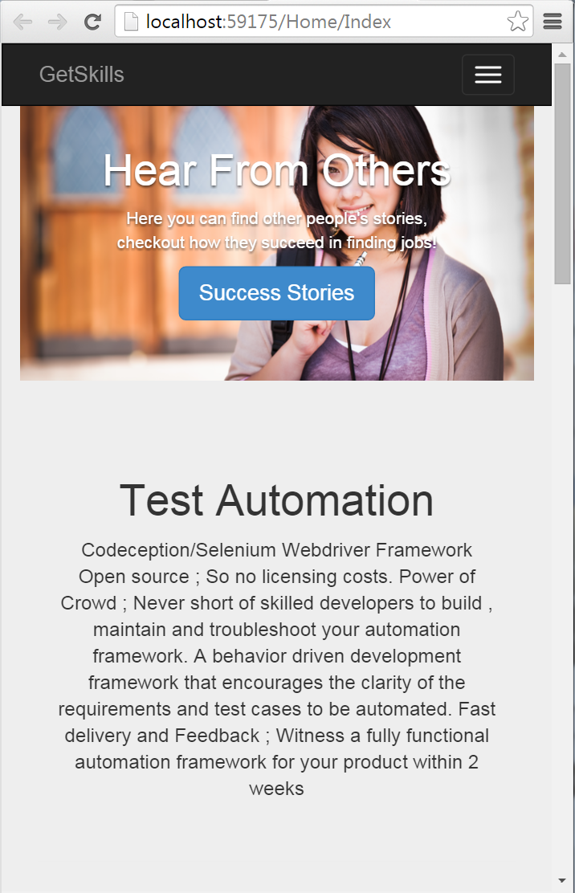
5. Mobile Friendly
Previously the image will take over the whole page
Now we add screen detection control to increase mobile user experience

Slide 7
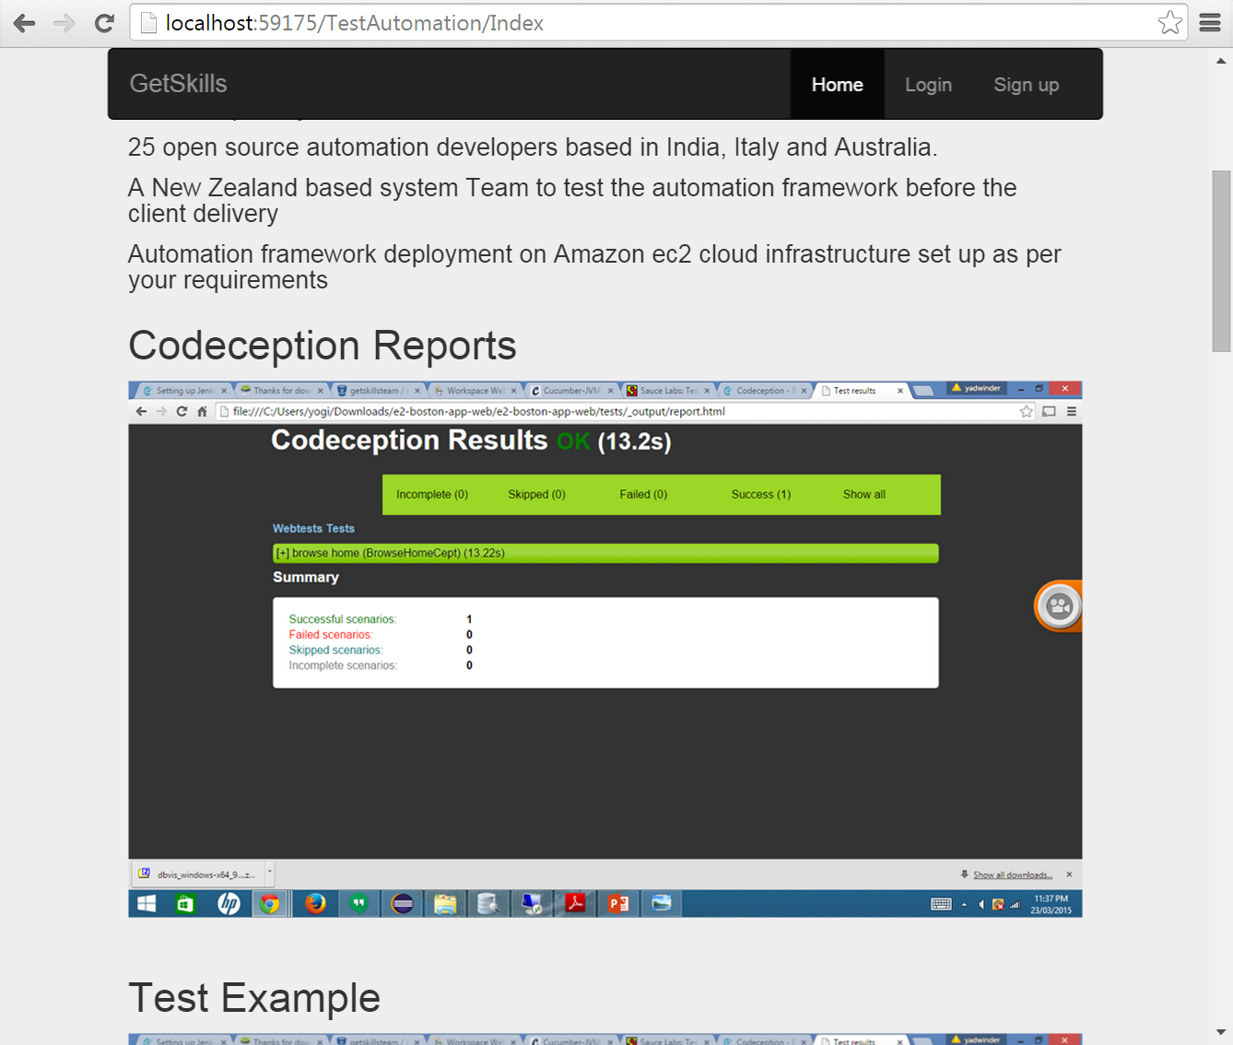
6. Test Automation

Slide 8
7. Team Profile
Client view
Client view page
Admin function
List page
Add page
Edit page
Delete page

Slide 9
8. Test for Team Profile
Unit: case

Slide 10
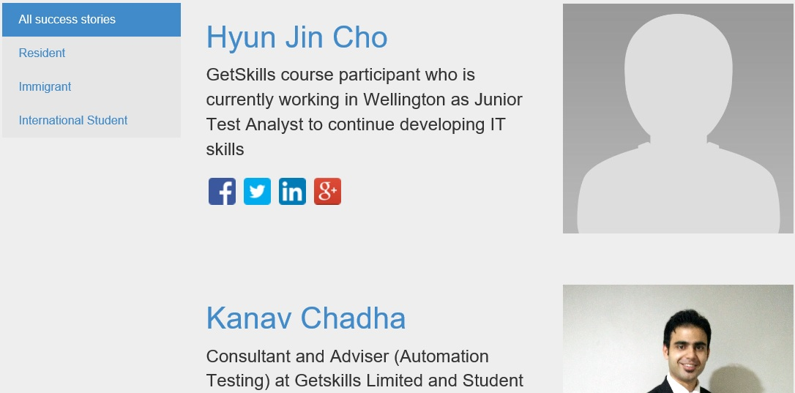
9. Success Story
Finalised Success Story Categories
Real time data incorporated in the DB
Dynamic data / Real-time data is used in Success Stories, depending upon the user selection
Social Media links added to the GetSkills alumni.

Slide 11
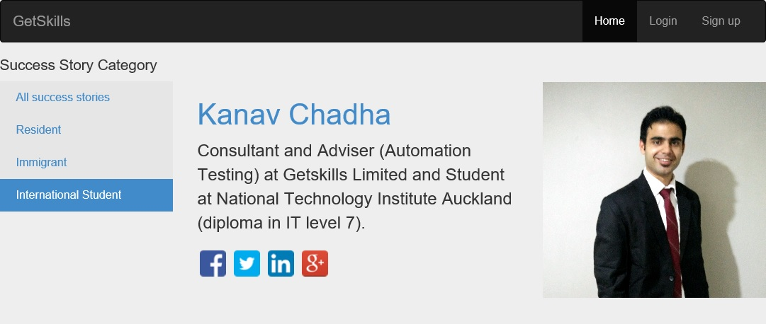
– Detail view
10. Success Story Category
Detail view of Success Story is Dynamic / Real time data.
Social Media links added to the Alumni.

Slide 12
11. Future Enhancements
In future an app can be developed, that contains details about GetSkills, which can be added to GetSkills website and visitors can download the same
HR module for GetSkills employees can be developed in future.

Slide 13
Q&A

